Slide 1

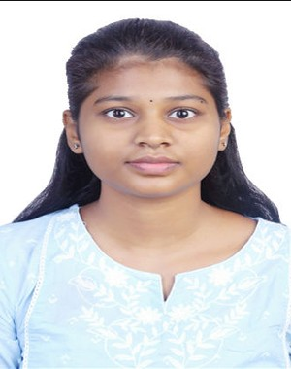
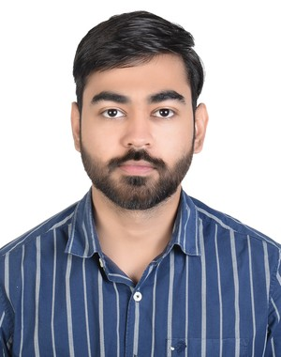
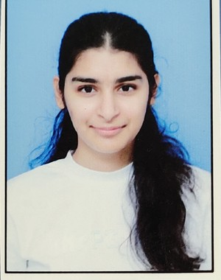
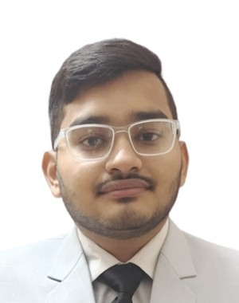
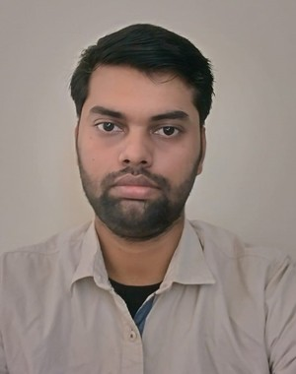
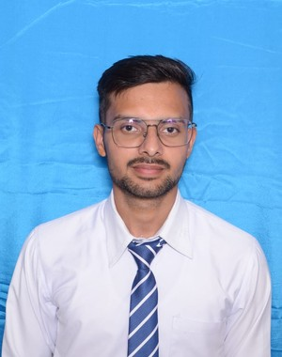
Wipro-Capstone: Best Team
Slides 1-4 presented by: Aditya Jain
ParaBank Automation Testing
End-to-End Banking Application Automation Using Selenium, Python & Pytest-BDD
Capstone Project
GitHub:
https://github.com/Pritanjan/
parabank_automation_capstone.git
Our Team
Priyanshu Pandey
Lavanya Challapalli
Aditya Jain
Ishika Singh
Shubham Pandey
Pritanjan Baranwal
Abhay Shukla
1/19

Slide 2
Wipro-Capstone: Best Team
Table of Contents
Slides 1-4 presented by: Aditya Jain
1
Team Contribution
9
Automation Framework Workflow
2
Introduction
10
Page Object Model (POM)
3
Problem Statement
11
Test Execution Results
4
Objectives
12
Test Outcomes
5
Tech Stack
13
Reports & Screenshots
6
Project Structure
14
Challenges & Solutions
7
BDD Framework
15
Conclusion
8
Functional Modules Automated
2/19

Slide 3

Team Contribution
Slides 1-4 presented by: Aditya Jain
Team Member | Feature / Module Assigned
Priyanshu Pandey B.Tech - CSE priyanshurider123@gmail.com | Authentication Handling
Lavanya Challapalli B.Tech - IT challapallilavanya26@gmail.com | Account Management
Aditya Jain B.Tech - CSE adityajain29502@gmail.com | Transaction Management
Ishika Singh B.Tech - ECE ishikachauhan259@gmail.com | Payments and statements Handling
Shubham Pandey B.Tech - CSE shubhampandeysp357@gmail.com | User Profile Management
Pritanjan Baranwal B.Tech - IT pritanjanb@gmail.com | Loan Management
Abhay Shukla B.Tech - CSE abhaysh1503@gmail.com | Recovery & Loan Processing
3/19

Slide 4

Wipro-Capstone: Best Team
Introduction
Slides 1-4 presented by: Aditya Jain
ParaBank is a web-based banking application used for automation testing.
This project automates banking workflows using Selenium WebDriver.
Python is used for automation scripting.
ParaBank
Pytest-BDD framework is used for writing test scenarios.
Web-Based Banking
Test Application
Page Object Model (POM) is used for reusable automation code.
Selenium
Python
Automation improves testing speed, accuracy, and efficiency.
Pytest-BDD
POM
4/19

Slide 5





Wipro-Capstone: Best Team
Problem Statement
Slides 5-6 presented by: Priyanshu Pandey
Repetitive & Time-Consuming
Regression Testing Burden
Manual testing requires repeated effort for every release cycle.
Regression testing demands repeated execution — prone to being skipped.
Human Error Risk
Complex Workflow Management
Human errors may occur during repetitive and monotonous testing tasks.
Managing multi-step banking workflows manually is difficult and error-prone.
Need for Faster, Reliable Testing
Faster, accurate, and repeatable testing is essential for quality banking applications.
5/19

Slide 6
Slides 5-6 presented by: Priyanshu Pandey
Wipro-Capstone: Best Team
Objectives
🏦 End-to-End Automation Automate major banking functionalities end-to-end.
🐍 Selenium with Python Implement Selenium automation scripting using Python.
🧪 Pytest-BDD Framework Use Pytest-BDD framework for behavior-driven test scenarios.
📐 Page Object Model Follow Page Object Model (POM) design pattern.
✅ Test Scenarios Validate positive and negative test scenarios.
📊 HTML Reports Generate HTML reports for test execution tracking.
6/19

Slide 7
Wipro-Capstone: Best Team
Tech Stack
Slides 7-8 presented by:Challapalli Lavanya
Python 3.14
Primary programming language for automation scripting
Selenium WebDriver
Browser automation — simulates real user interactions
Pytest
Test execution engine and test runner
Pytest-BDD
Behavior Driven Development framework for test scenarios
Page Object Model
Design pattern for reusable and maintainable automation code
ChromeDriver
Chrome browser driver for Selenium automation
Git & GitHub
Version control and collaborative code management
HTML Reports
Execution results and test report generation via pytest-html
7/19

Slide 8
Wipro-Capstone: Best Team
Slides 7-8 presented by: Challapalli Lavanya
Project Structure
Parabank_Automation_Capstone/
│
├── features/
│ ├── login.feature
│ ├── logout.feature
│ ├── open_new_account.feature
│ ├── accounts_overview.feature
│ ├── transfer_funds.feature
│ ├── account_balance.feature
│ ├── bill_payment.feature
│ ├── transaction_history.feature
│ ├── find_transactions.feature
│ ├── registration.feature
│ ├── update_contact_information.feature
│ ├── loan_approval.feature
│ ├── loan_rejection.feature
│ ├── dashboard.feature
│ └── forget_login_info.feature
├── pages/
│ ├── base_page.py
│ ├── login_page.py
│ ├── logout_page.py
│ ├── open_new_account_page.py
│ ├── accounts_overview_page.py
│ ├── transfer_funds_page.py
│ ├── bill_payment_page.py
│ ├── transaction_history_page.py
│ ├── find_transactions_page.py
│ ├── registration_page.py
│ ├── update_contact_page.py
│ ├── dashboard_page.py
│ ├── loan_request.py
│ ├── loan_approval_page.py
│ └── forget_login_info.py
├── tests/
│ ├── test_login_steps.py
│ ├── test_logout_steps.py
│ ├── test_open_new_account_steps.py
│ ├── test_accounts_overview.py
│ ├── test_transfer_fund.py
│ ├── test_account_balance_steps.py
│ ├── test_bill_payment_steps.py
│ ├── test_transaction_history_steps.py
│ ├── find_transactions_steps.py
│ ├── test_registration.py
│ ├── test_update_contact_steps.py
│ ├── test_dashboard.py
│ ├── test_loan_application.py
│ ├── test_loan_approval.py
│ ├── test_loan_request.py
│ └── test_forget_login_info.py
├── reports/
│ ├── screenshots/
│ └── html_reports/
│
├── requirements.txt
├── pytest.ini
├── conftest.py
└── README
GitHub:
https://github.com/Pritanjan/
parabank_automation_capstone.git
8/19

Slide 9
Slides 9-10 presented by: Ishika Singh
Wipro-Capstone: Best Team
BDD Framework — Behavior Driven Development
What is BDD?
Feature File
✓ BDD = Behavior Driven Development
▼
Step Definition
✓ Writes test cases in simple readable language
▼
✓ Scenarios use Given / When / Then format
Page Object
Feature: Login Functionality
▼
Selenium Actions
Scenario: Valid Login
▼
Given user is on login page
Reports
When user enters valid credentials
Then user should login successfully
★ Easy to understand
★ Better readability
★ Organized scenarios
★ Reusable steps
9/19

Slide 10




Slides 9-10 presented by: Ishika Singh
Wipro-Capstone: Best Team
Functional Modules Automated
Authentication
Account Management
Transaction
› Login
› Open New Account
› Fund Transfer
› Logout
› Account Overview
› Bill Payment
› Session Handling
› Balance Checking
› Transaction History
› Forgot Login Information
› Find Transactions
User Management
Loan Module
Dashboard
› Registration
› Loan Application
› Dashboard Validation
› Update Contact Information
› Loan Approval
› Loan Rejection
10/19

Slide 11





Slides 11-12 presented by: Shubham Pandey
Wipro-Capstone: Best Team
Automation Framework Workflow
Feature File
→
Step Definition
→
Page Object
→
Selenium Actions
→
Reports
Test scenarios written in Gherkin (Given/When/Then)
Python functions that map to Gherkin scenario steps
Page classes containing web element locators & methods
Browser interactions — click, type, navigate, verify
pytest-html reports with pass/fail results & screenshots
Each layer has a single responsibility — keeping the framework modular, readable, and easy to maintain.
11/19

Slide 12

Slides 11-12 presented by: Shubham Pandey
Wipro-Capstone: Best Team
Page Object Model (POM)
Test Files
(Step Definitions)
Page Objects
(Locators & Methods)
Web Application
(Browser Elements)
→
→
Separate page classes created for each screen — improves reusability.
Web elements and methods are managed inside dedicated page files.
Improves code readability and framework maintenance.
Reduces code duplication across test cases.
Makes the framework scalable as more features are added.
12/19

Slide 13
Slides 13-14 presented by: Pritanjan Baranwal
Wipro-Capstone: Best Team
Test Execution Results
44
43
1
0
Total Tests
Passed
Failed
Errors
✓ Pass Rate: 97.7%
⚠ Note
One test case failed due to a fixture-related validation issue during execution. All remaining 43 workflows executed successfully.
Environment: Python 3.14.4 | pytest 9.0.3 | Windows 11 | Report generated: 21-May-2026
13/19

Slide 14

Slides 13-14 presented by: Pritanjan Baranwal
Wipro-Capstone: Best Team
Test Outcomes
✓ Successful Outcomes
⚙ Framework Outcomes
Login and logout functionalities executed successfully.
Reusable automation framework implemented using POM.
New account creation validated successfully.
BDD scenarios executed using Pytest-BDD.
Fund transfer and balance updates verified.
HTML reports generated successfully.
Bill payment workflows executed correctly.
Automated execution reduced manual testing effort.
Loan approval and rejection validations completed successfully.
Dashboard and transaction history validations passed.
43
Total Test Cases
Automated Successfully
14/19

Slide 15
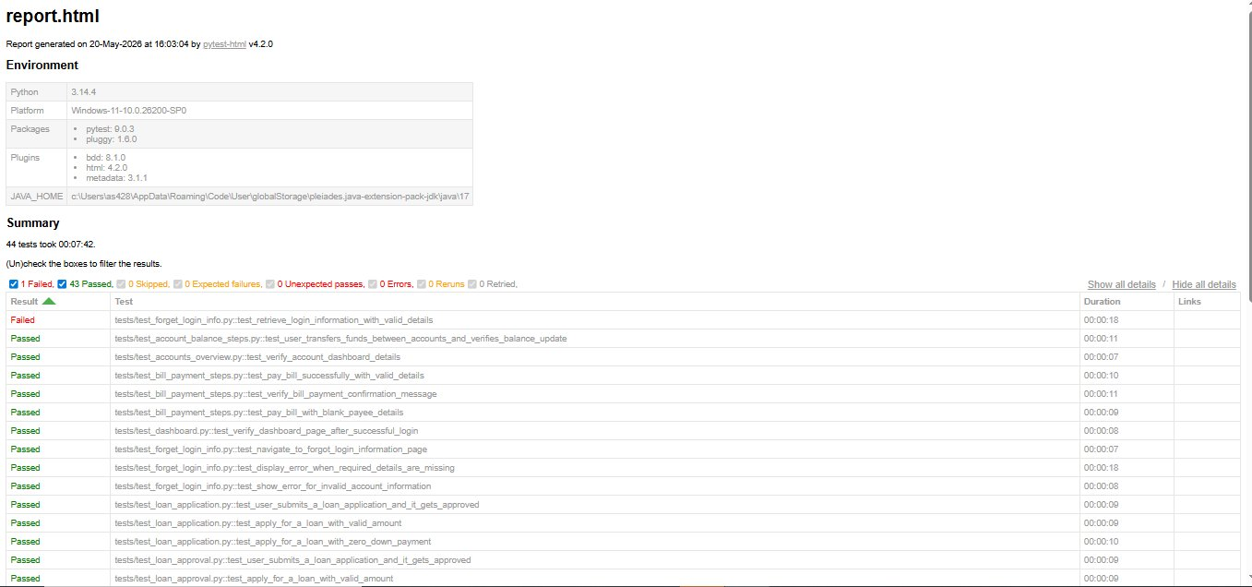
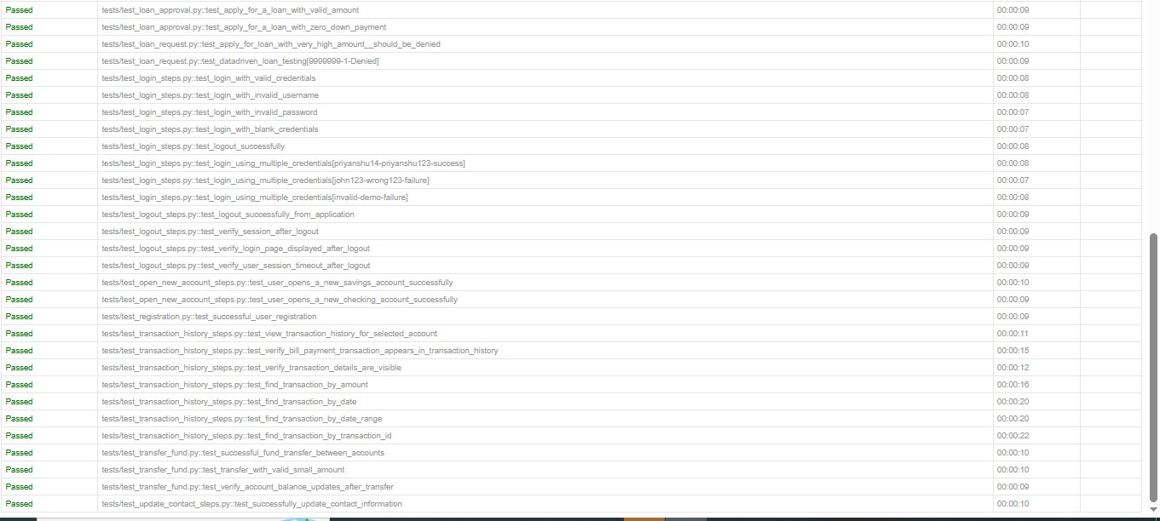
Slides 15-19 presented by: Abhay Shukla
Wipro-Capstone: Best Team
Reports & Screenshots
HTML report generated using
pytest-html
plugin — auto-generates structured test results after every run.
✓ Passed: 43
✗ Failed: 1
Report Summary View
Test Case Results Detail
★ Full HTML report contains all 44 test case results with duration and environment metadata.
15/19

Slide 16
Slides 15-19 presented by: Abhay Shukla
Wipro-Capstone: Best Team
Challenges & Solutions
Challenge | Solution Implemented
Dynamic element loading delays | Used WebDriverWait for dynamic element detection
Synchronization issues between steps | Implemented explicit waits across all page interactions
Reusable code management | Adopted Page Object Model (POM) design pattern
Test data conflicts across scenarios | Used parameterized and dynamic test data strategies
Report generation and test tracking | Generated detailed HTML reports via pytest-html plugin
16/19

Slide 17

Slides 15-19 presented by: Abhay Shukla
Wipro-Capstone: Best Team
Conclusion
Successfully implemented Selenium automation using Python and Pytest-BDD for a real banking application.
Understood the importance of Page Object Model (POM) for reusable and maintainable automation code.
Learned to automate real-time banking workflows including login, fund transfer, loans, and more.
Gained practical knowledge of feature files, step definitions, and BDD framework structure.
Improved understanding of test execution, HTML report generation, and automation framework workflow.
Successfully validated both positive and negative test scenarios for all banking functionalities.
Enhanced teamwork, automation testing skills, and practical knowledge of software testing.
17/19

Slide 18
Slides 15-19 presented by: Abhay Shukla
Wipro-Capstone: Best Team
Future Enhancements
01
CI/CD Integration
Integrate test execution with Jenkins, GitHub Actions, or Azure Pipelines for continuous testing.
02
Cross-Browser Testing
Extend automation to support Firefox, Edge, and Safari using Selenium Grid.
03
Data-Driven Testing
Implement data-driven approach using Excel or JSON files for wider test coverage.
04
Improved Reporting
Enhance report visualization with Allure Reports for richer test analytics.
05
Extended Coverage
Automate additional banking workflows and edge cases not covered in this phase.
18/19

Slide 19
Slides 15-19 presented by: Abhay Shukla
Wipro-Capstone: Best Team
Thank You!
Questions & Feedback Welcome
Our Team
• Priyanshu Pandey
• Shubham Pandey
• Lavanya Challapalli
• Pritanjan Baranwal
• Aditya Jain
• Abhay Shukla
• Ishika Singh
parabank.parasoft.com
For any queries: shubhampandeysp357@gmail.com
Capstone Project • Best Team
19

